Slide 1


HR Attrition Analytics Report
Attrition is a gradual but deliberate reduction in staff numbers that occurs as employees leave a company and are not replaced.

Slide 2
Introduction
XYZ company which was established a few years back is facing around a 15% attrition rate for a couple of years.
And it's majorly affecting the company in many aspects.
So in order to understand and getting meaningful insights why employees are leaving the company and reduce the attrition rate of XYZ company I do Analytics on their Past Year Data and build a dashboard.

Slide 3
Details of Data
Number of Employees: The organization currently has 1470 employees.
Attrition Count: There have been 237 instances of attrition.
Attrition Rate: The overall attrition rate stands at 16%.
Average Age: The average age of employees in the organization is 37 years.
Distance From Home: On average, employees live approximately 7 kilometers away from their workplace.
Years at Company: The average tenure of employees with the company is 7 years.

Slide 4
Key Point Indicators
1. Attrition Rate
2. Gender
3. Age Group
4. Salary Slab
5. Education Field
6. Job Role
7. Job Role Satisfaction

Slide 5
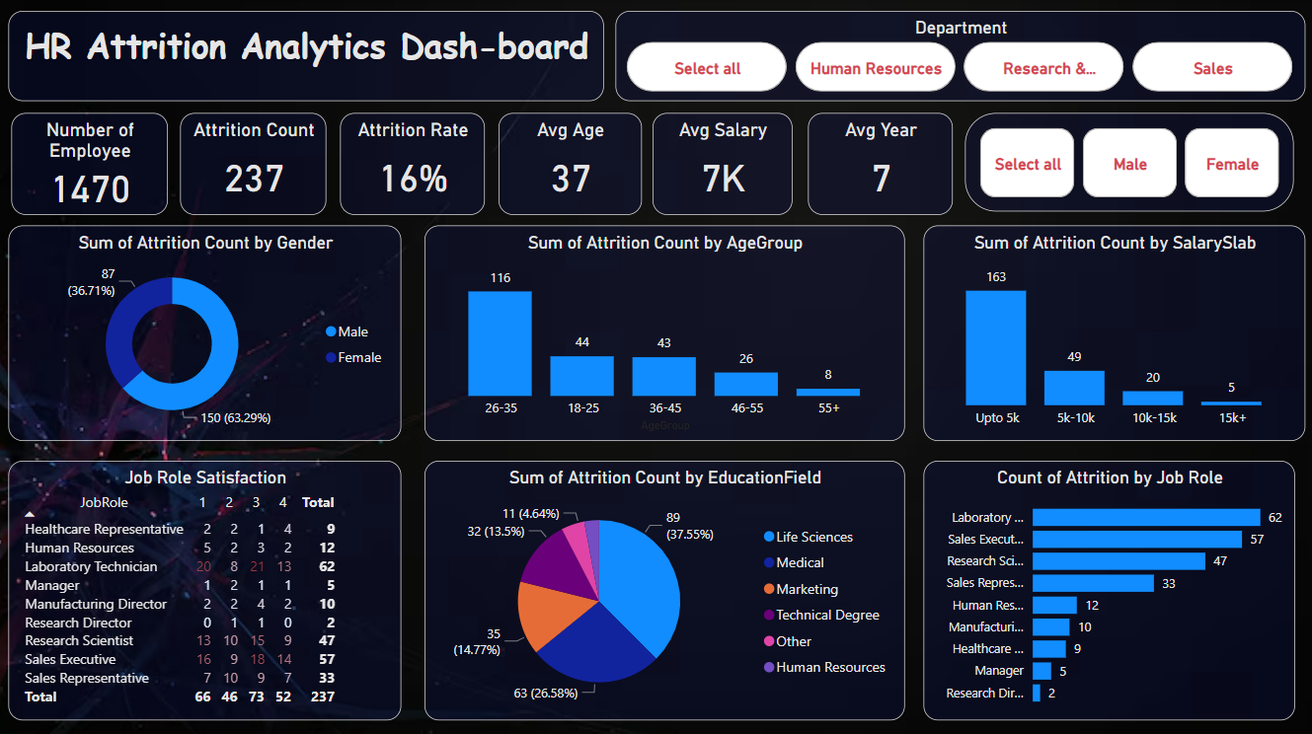

Slide 6
Insights :
The gender of employees are distributed fairly at 63.29% for Male and 36.71% for Females
An average employee age of 37 may indicate a fairly healthy and strong workforce.
Since its conception, this company has retired 237 staff, with 1233 employees still in service.
Time spent training has been strongly improving performance and should be highly encouraged.

Slide 7
Thank You

